Slide 1
Related work: Movement Automaton Surveillance Navigation Reach set estimation
Notes:
There are two modes Cooperative and non cooperative,
our solution supports both

Slide 2
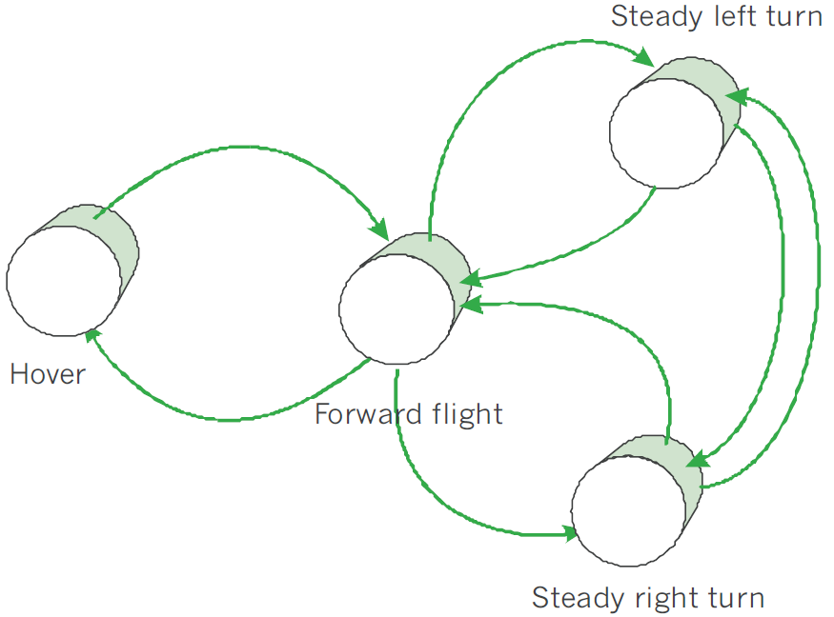
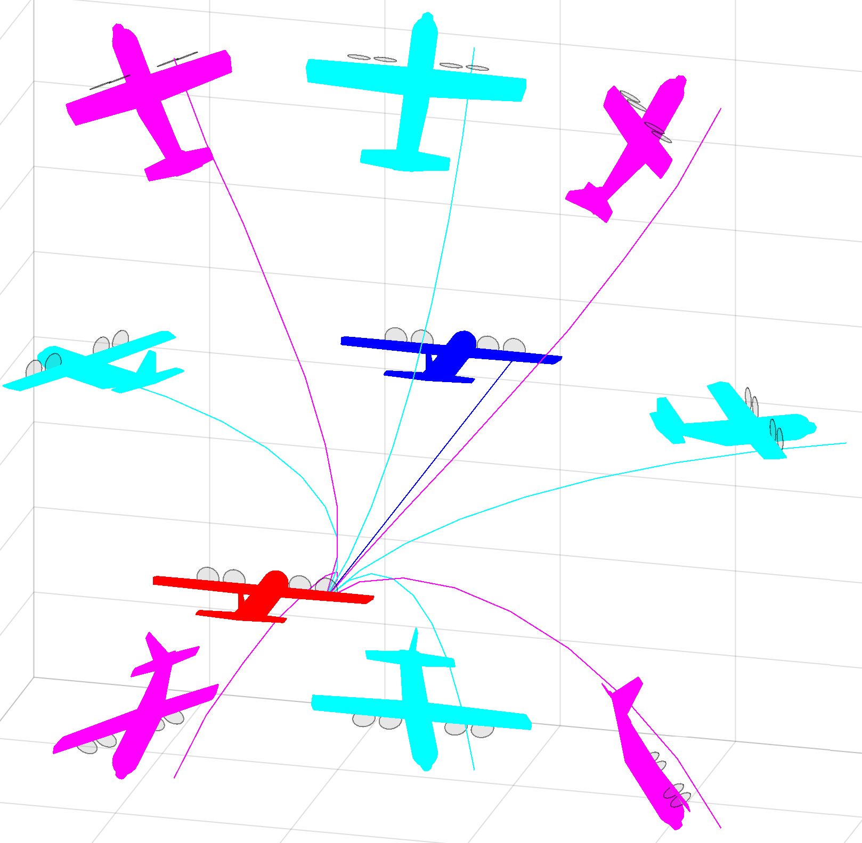
Related work: Movement automaton (5.1)
Related work:
[15] Emilio Frazzoli. Robust hybrid control for autonomous vehicle motion planning. PhD thesis, Massachusetts Institute of Technology, 2001.
[91] Emilio Frazzoli, Munther A Dahleh, and Eric Feron. Trajectory tracking control design for autonomous helicopters using a backstepping algorithm. In American Control Conference, 2000. Proceedings of the 2000, volume 6, pages 4102{4107. IEEE, 2000.

Slide 3
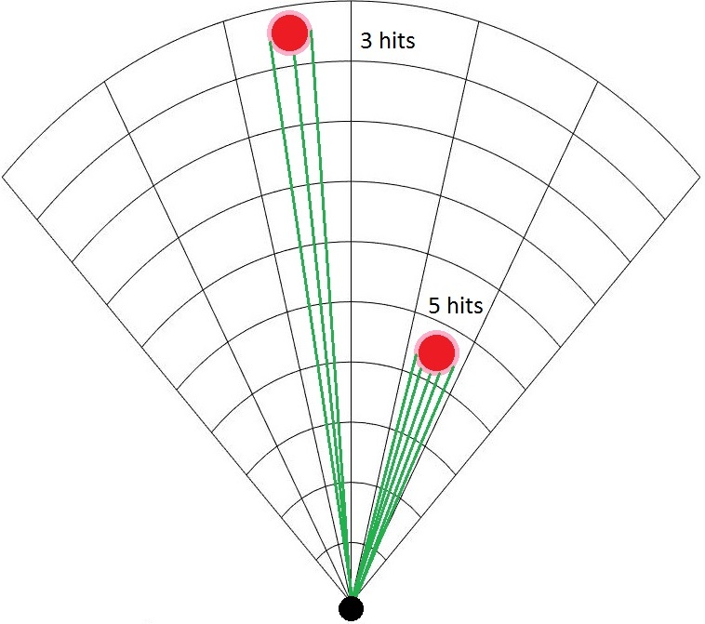
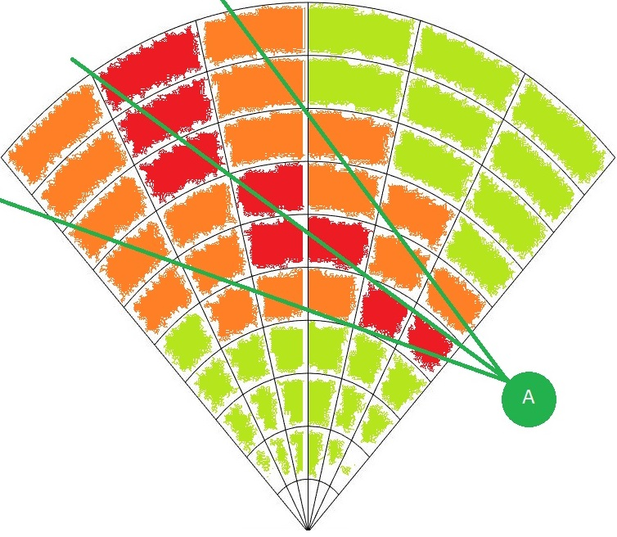
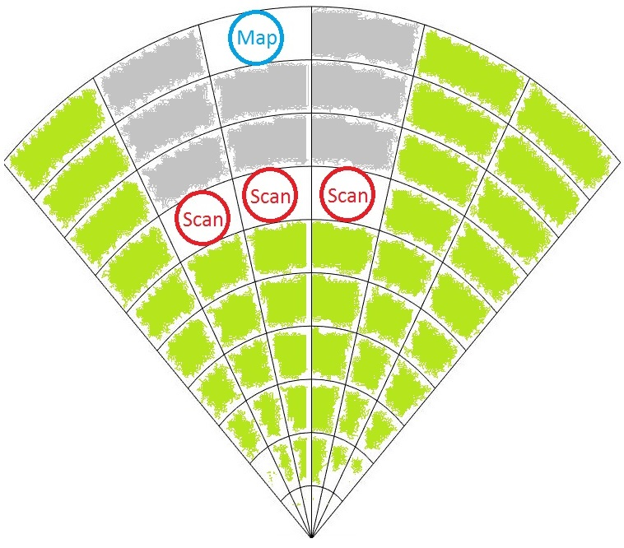
Related work: Surveillance (5.2)
Related work:
[98] Fredrik Gustafsson. Statistical sensor fusion. Studentlitteratur, 2010.
[99] Subramanian Ramasamy, Roberto Sabatini, Alessandro Gardi, and Trevor Kistan.
Next generation fight management system for real-time trajectory based
operations. Applied Mechanics and Materials, 629:344-349, 2014.
[100] Yuriy Chynchenko, Tatyana Shmelova, and Oksana Chynchenko. Remotely
piloted aircraft systems operations under uncertainty conditions. Proceedings of
the National Aviation University, 1(1):18-22, 2016.
[101] T Shmelova, D Bondarev, and Y Znakovska. Modeling of the decision making by
UAS operator in emergency situations. In Methods and Systems of Navigation
and Motion Control (MSNMC), 2016 4th International Conference on, volume 1,
pages 31-34. IEEE, 2016.

Slide 4
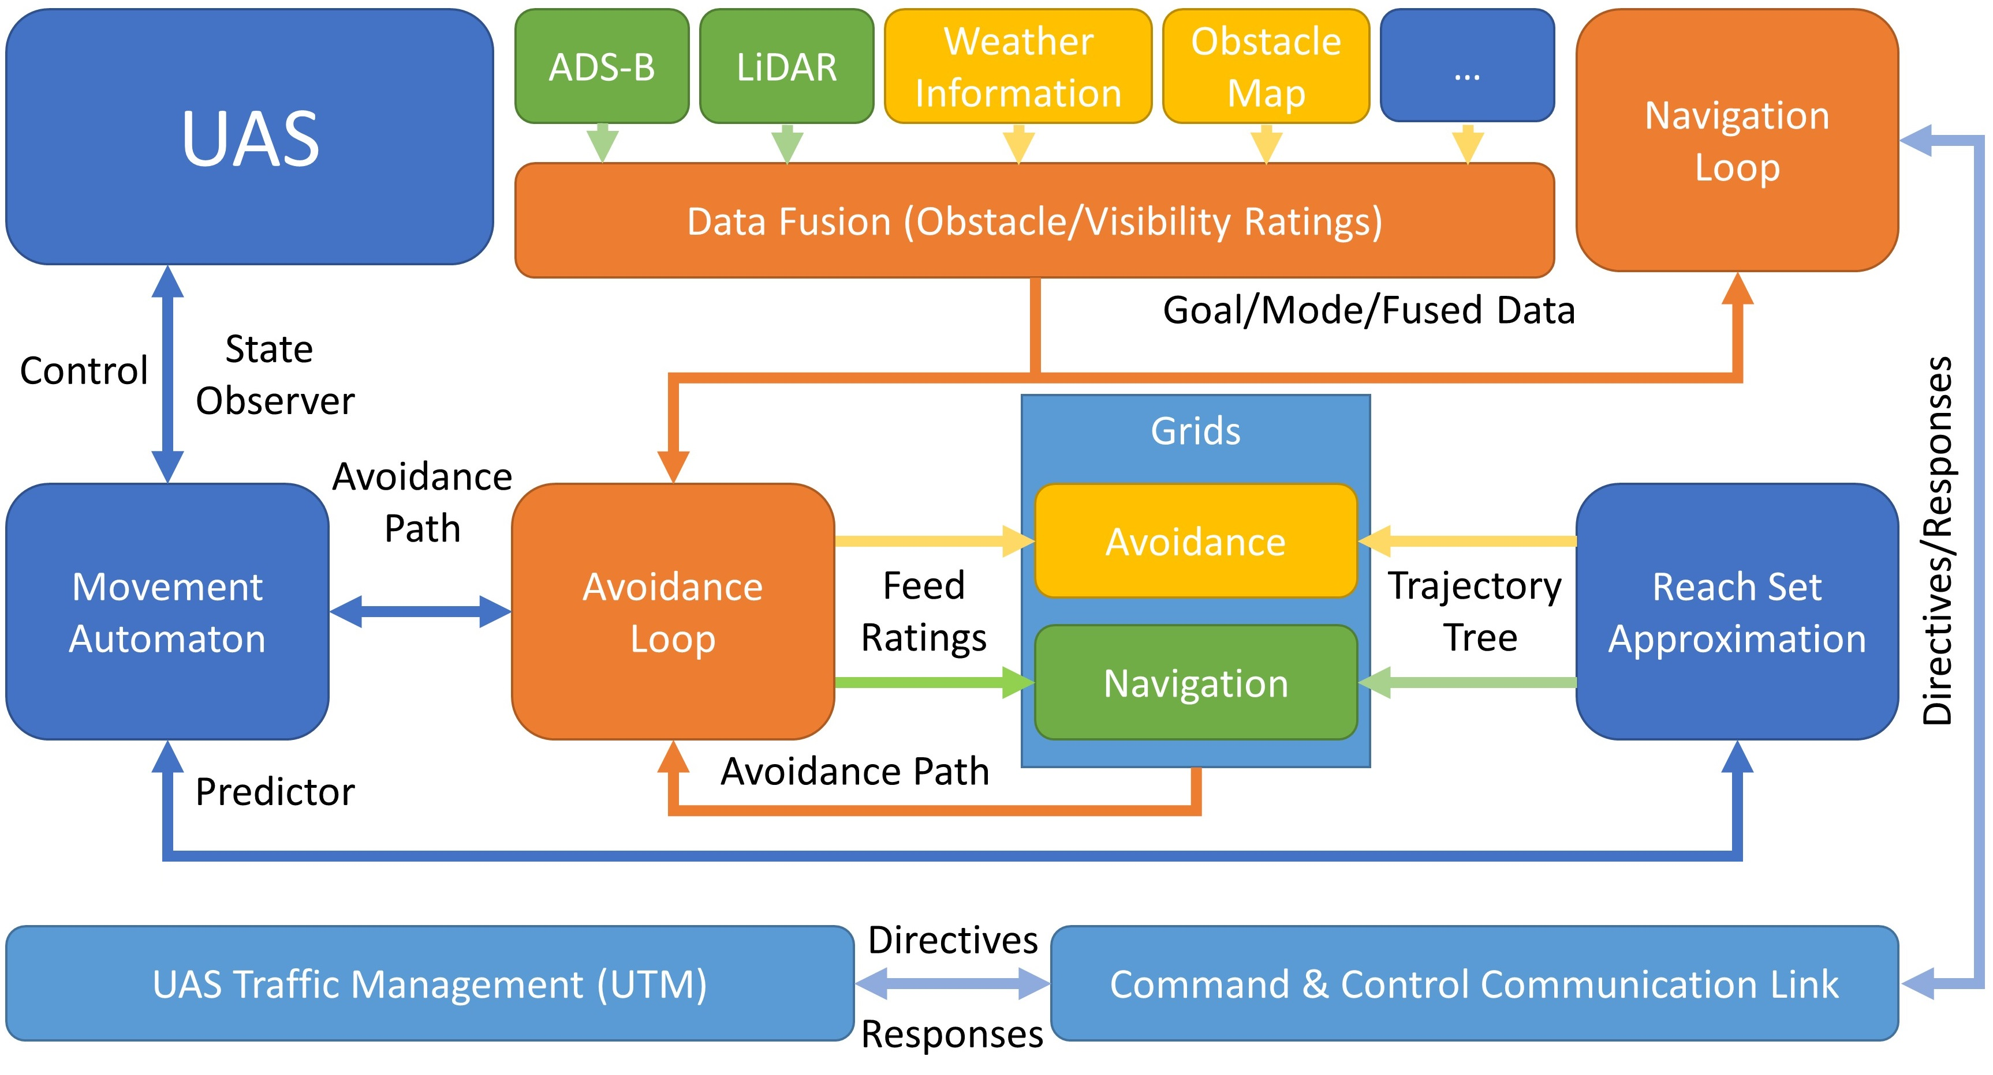
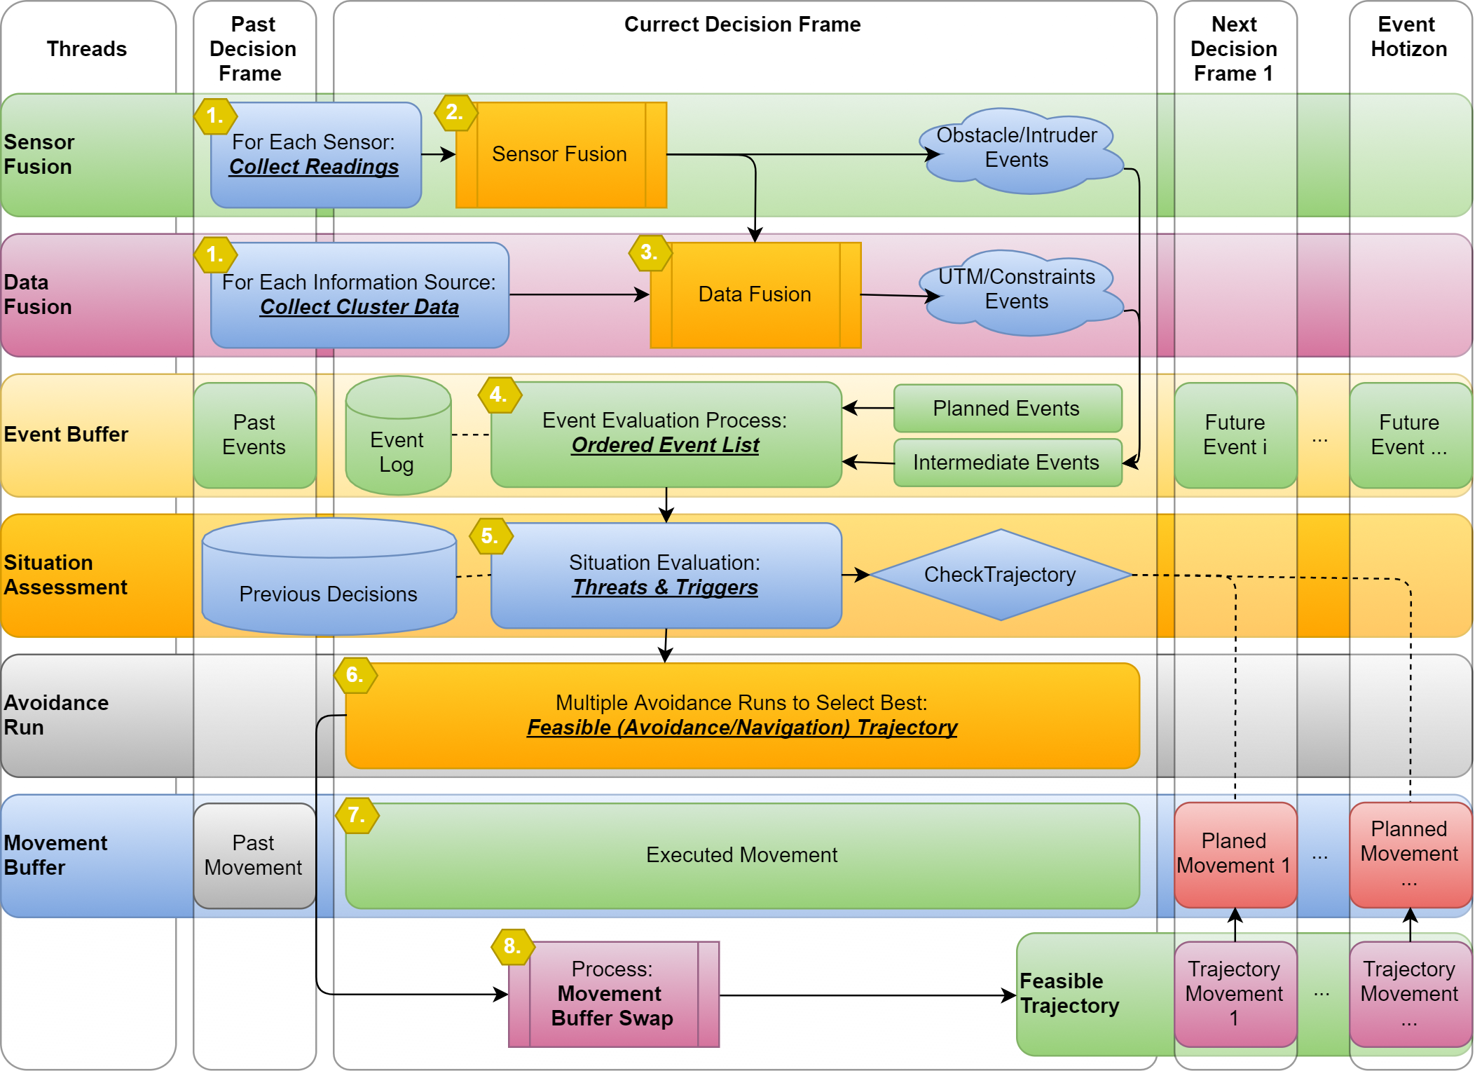
Related work: Navigation (5.3)
Related work:
[167] Roberto Sabatini, Celia Bartel, Anish Kaharkar, Tesheen Shaid, and
Subramanian Ramasamy. Navigation and guidance system architectures for
small unmanned aircraft applications. International Journal of Mechanical,
Industrial Science and Engineering, 8(4):733-752, 2014.
[168] Roberto Sabatini, Alessandro Gardi, and M Richardson. Lidar obstacle warning
and avoidance system for unmanned aircraft. International Journal of
Mechanical, Aerospace, Industrial and Mechatronics Engineering, 718-729,2014.

Slide 5
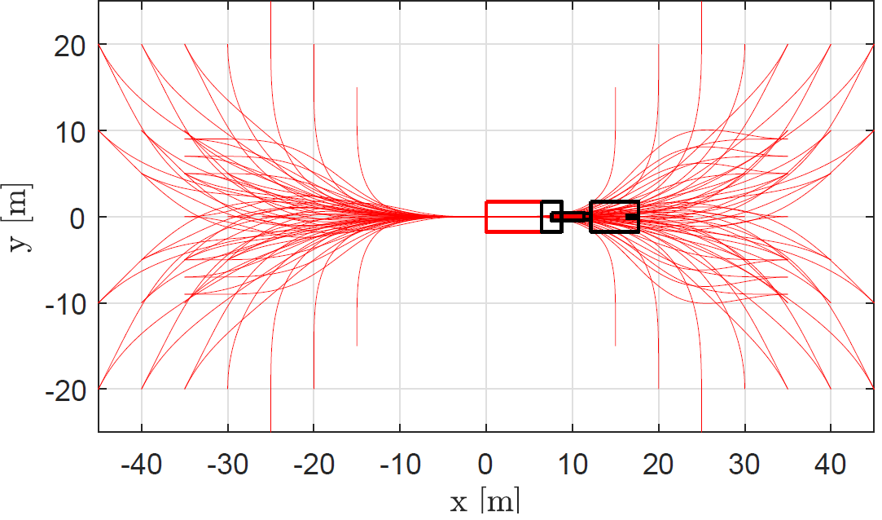
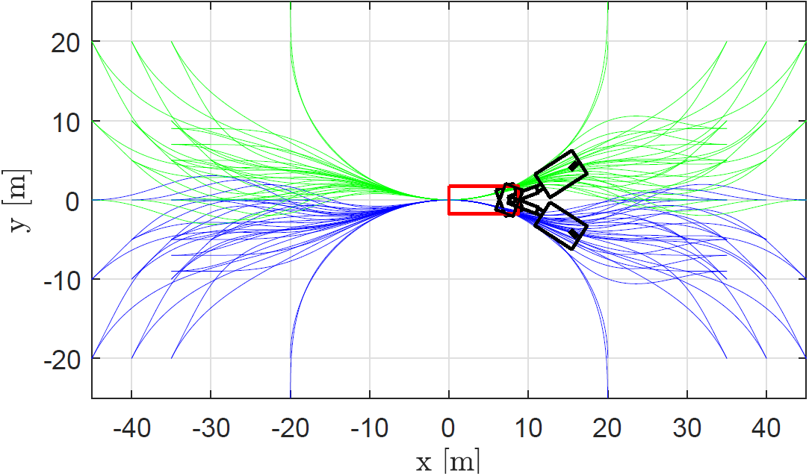
Related work: Reach Set Estimation (5.4)
Related work:
[108] Steven M LaValle, Michael S Branicky, and Stephen R Lindemann. On the
relationship between classical grid search and probabilistic roadmaps. The
International Journal of Robotics Research, 23(7-8):673-692, 2004.
[109] Ira M Gessel. A probabilistic method for lattice path enumeration. Journal of
statistical planning and inference, 14(1):49-58, 1986.
[110] Floriana Esposito, Donato Malerba, Giovanni Semeraro, and J Kay. A
comparative analysis of methods for pruning decision trees. IEEE transactions
on pattern analysis and machine intelligence, 19(5):476{491, 1997.

